Slide 1
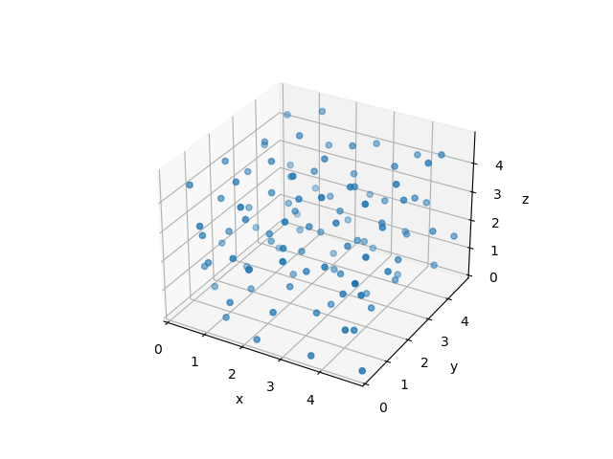
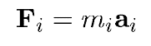
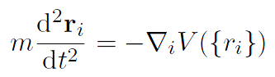
分子动力学
Force 𝑭 can be obtained by first-principles methods or force field
methods

Slide 2

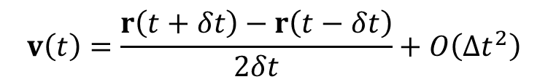
积分算法
Euler algorithm: simplest but worst
( ) ( ) ( )
O (Δt² )
r t + Δ
t = r t + v t Δt +
i
i
i
Verlet algorithm (Verlet, 1967)
( )
F t
Δt + ^{ri} Δt³ + O (Δt ⁴ )
( ) ( ) ( )
i
2
r t + Δ
t = r t + v t Δt +
i
i i
2m
6
( )
F t
Δt − ^{ri} Δt³ + O (Δt ⁴ )
( ) ( ) ( )
i
2
r t − Δ
t = r t − v t Δt +
i
i i
2m
6
( )
( ) ( ) ( )
F t
Δt + O (Δt ⁴ )
r t + Δ
t = 2r t − r t − Δt +
i
2
Δ𝑡~ 1 - 10 fs
i i i
m
$$v\left(t\right)=\frac{r\left(t+δt\right)−r\left(t−δt\right)}{2δt}+O\left(Δt^{2}\right)$$

Slide 3
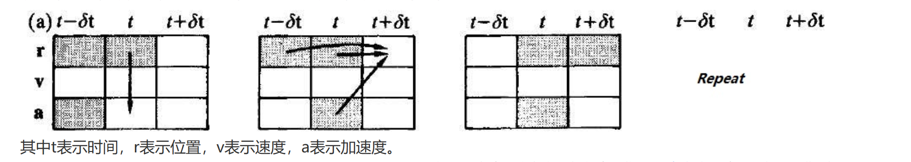
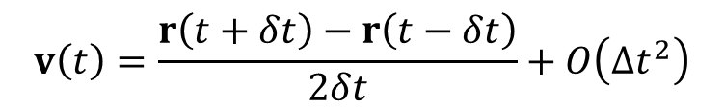
积分算法
Verlet algorithm (Verlet, 1967)
( )
( ) ( ) ( )
F t
Δt + O (Δt ⁴ )
r t + Δ
t = 2r t − r t − Δt +
i
2
Δ𝑡~ 1 - 10 fs
i i i
m
$$v\left(t\right)=\frac{r\left(t+δt\right)−r\left(t−δt\right)}{2δt}+O\left(Δt^{2}\right)$$

Slide 4
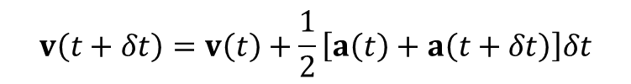
积分算法
velocity Verlet (Swope, 1982)
$r\left(t+δt\right)=r\left(t\right)+v\left(t\right)δt+\frac{1}{2}a\left(t\right)δt^{2}$+O（$δt^{3}$）
$$v\left(t+δt\right)=v\left(t\right)+a\left(t\right)δt+\frac{1}{2}\dot{a}\left(t\right)δt^{2}\text{+}\text{O}\text{（}δt^{3}\text{）}$$
$$v\left(t+δt\right)=v\left(t\right)+a\left(t\right)δt+\frac{1}{2}\frac{a\left(t+δt\right)−a\left(t\right)}{δt}δt^{2}\text{+}\text{O}\text{（}δt^{3}\text{）}$$
$$v\left(t+δt\right)=v\left(t\right)+\frac{1}{2}\left[a\left(t\right)+a\left(t+δt\right)\right]δt$$

Slide 5

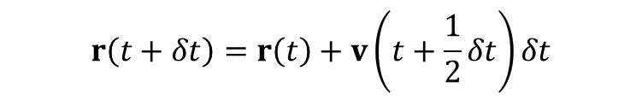
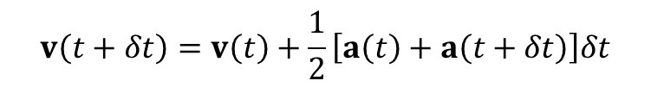
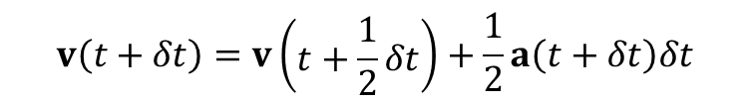
积分算法
velocity Verlet (Swope, 1982)
$r\left(t+δt\right)=r\left(t\right)+v\left(t\right)δt+\frac{1}{2}a\left(t\right)δt^{2}$+O（$δt^{3}$）
$$v\left(t+δt\right)=v\left(t\right)+\frac{1}{2}\left[a\left(t\right)+a\left(t+δt\right)\right]δt$$
速度计算相当于分成两步,半步速度
$$v\left(t+\frac{1}{2}δt\right)=v\left(t\right)+\frac{1}{2}a\left(t\right)δt$$
$$r\left(t+δt\right)=r\left(t\right)+v\left(t+\frac{1}{2}δt\right)δt$$
$$v\left(t+δt\right)=v\left(\begin{aligned}&t+\frac{1}{2}δt\end{aligned}\right)+\frac{1}{2}a\left(t+δt\right)δt$$

Slide 6
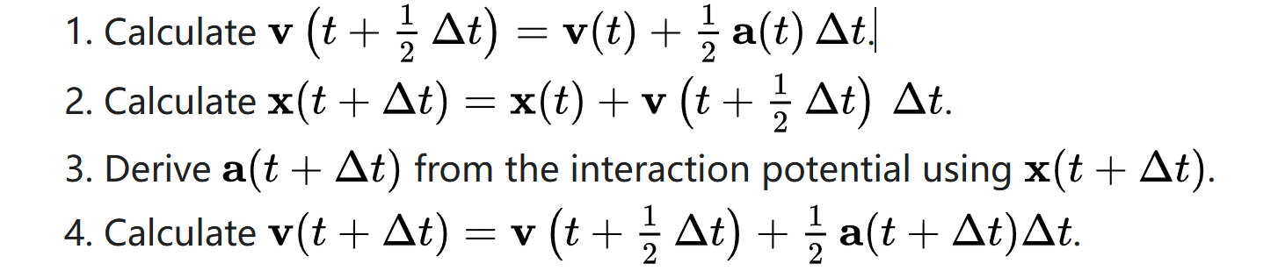
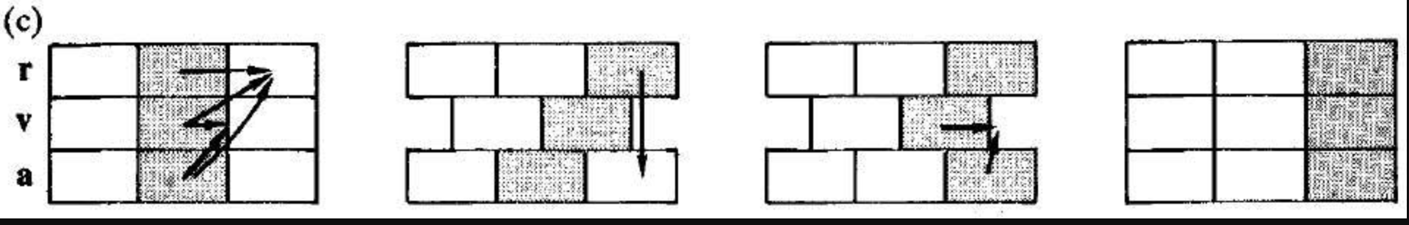
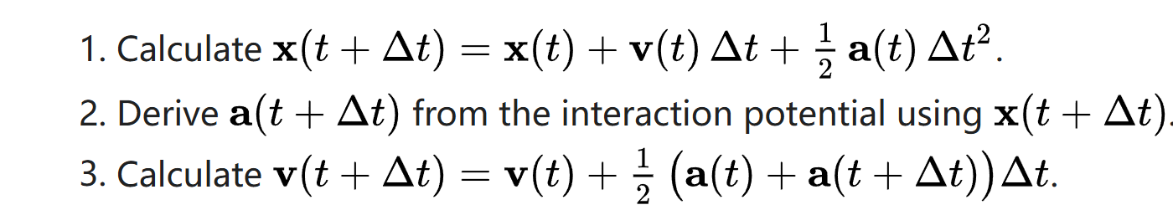

Slide 7
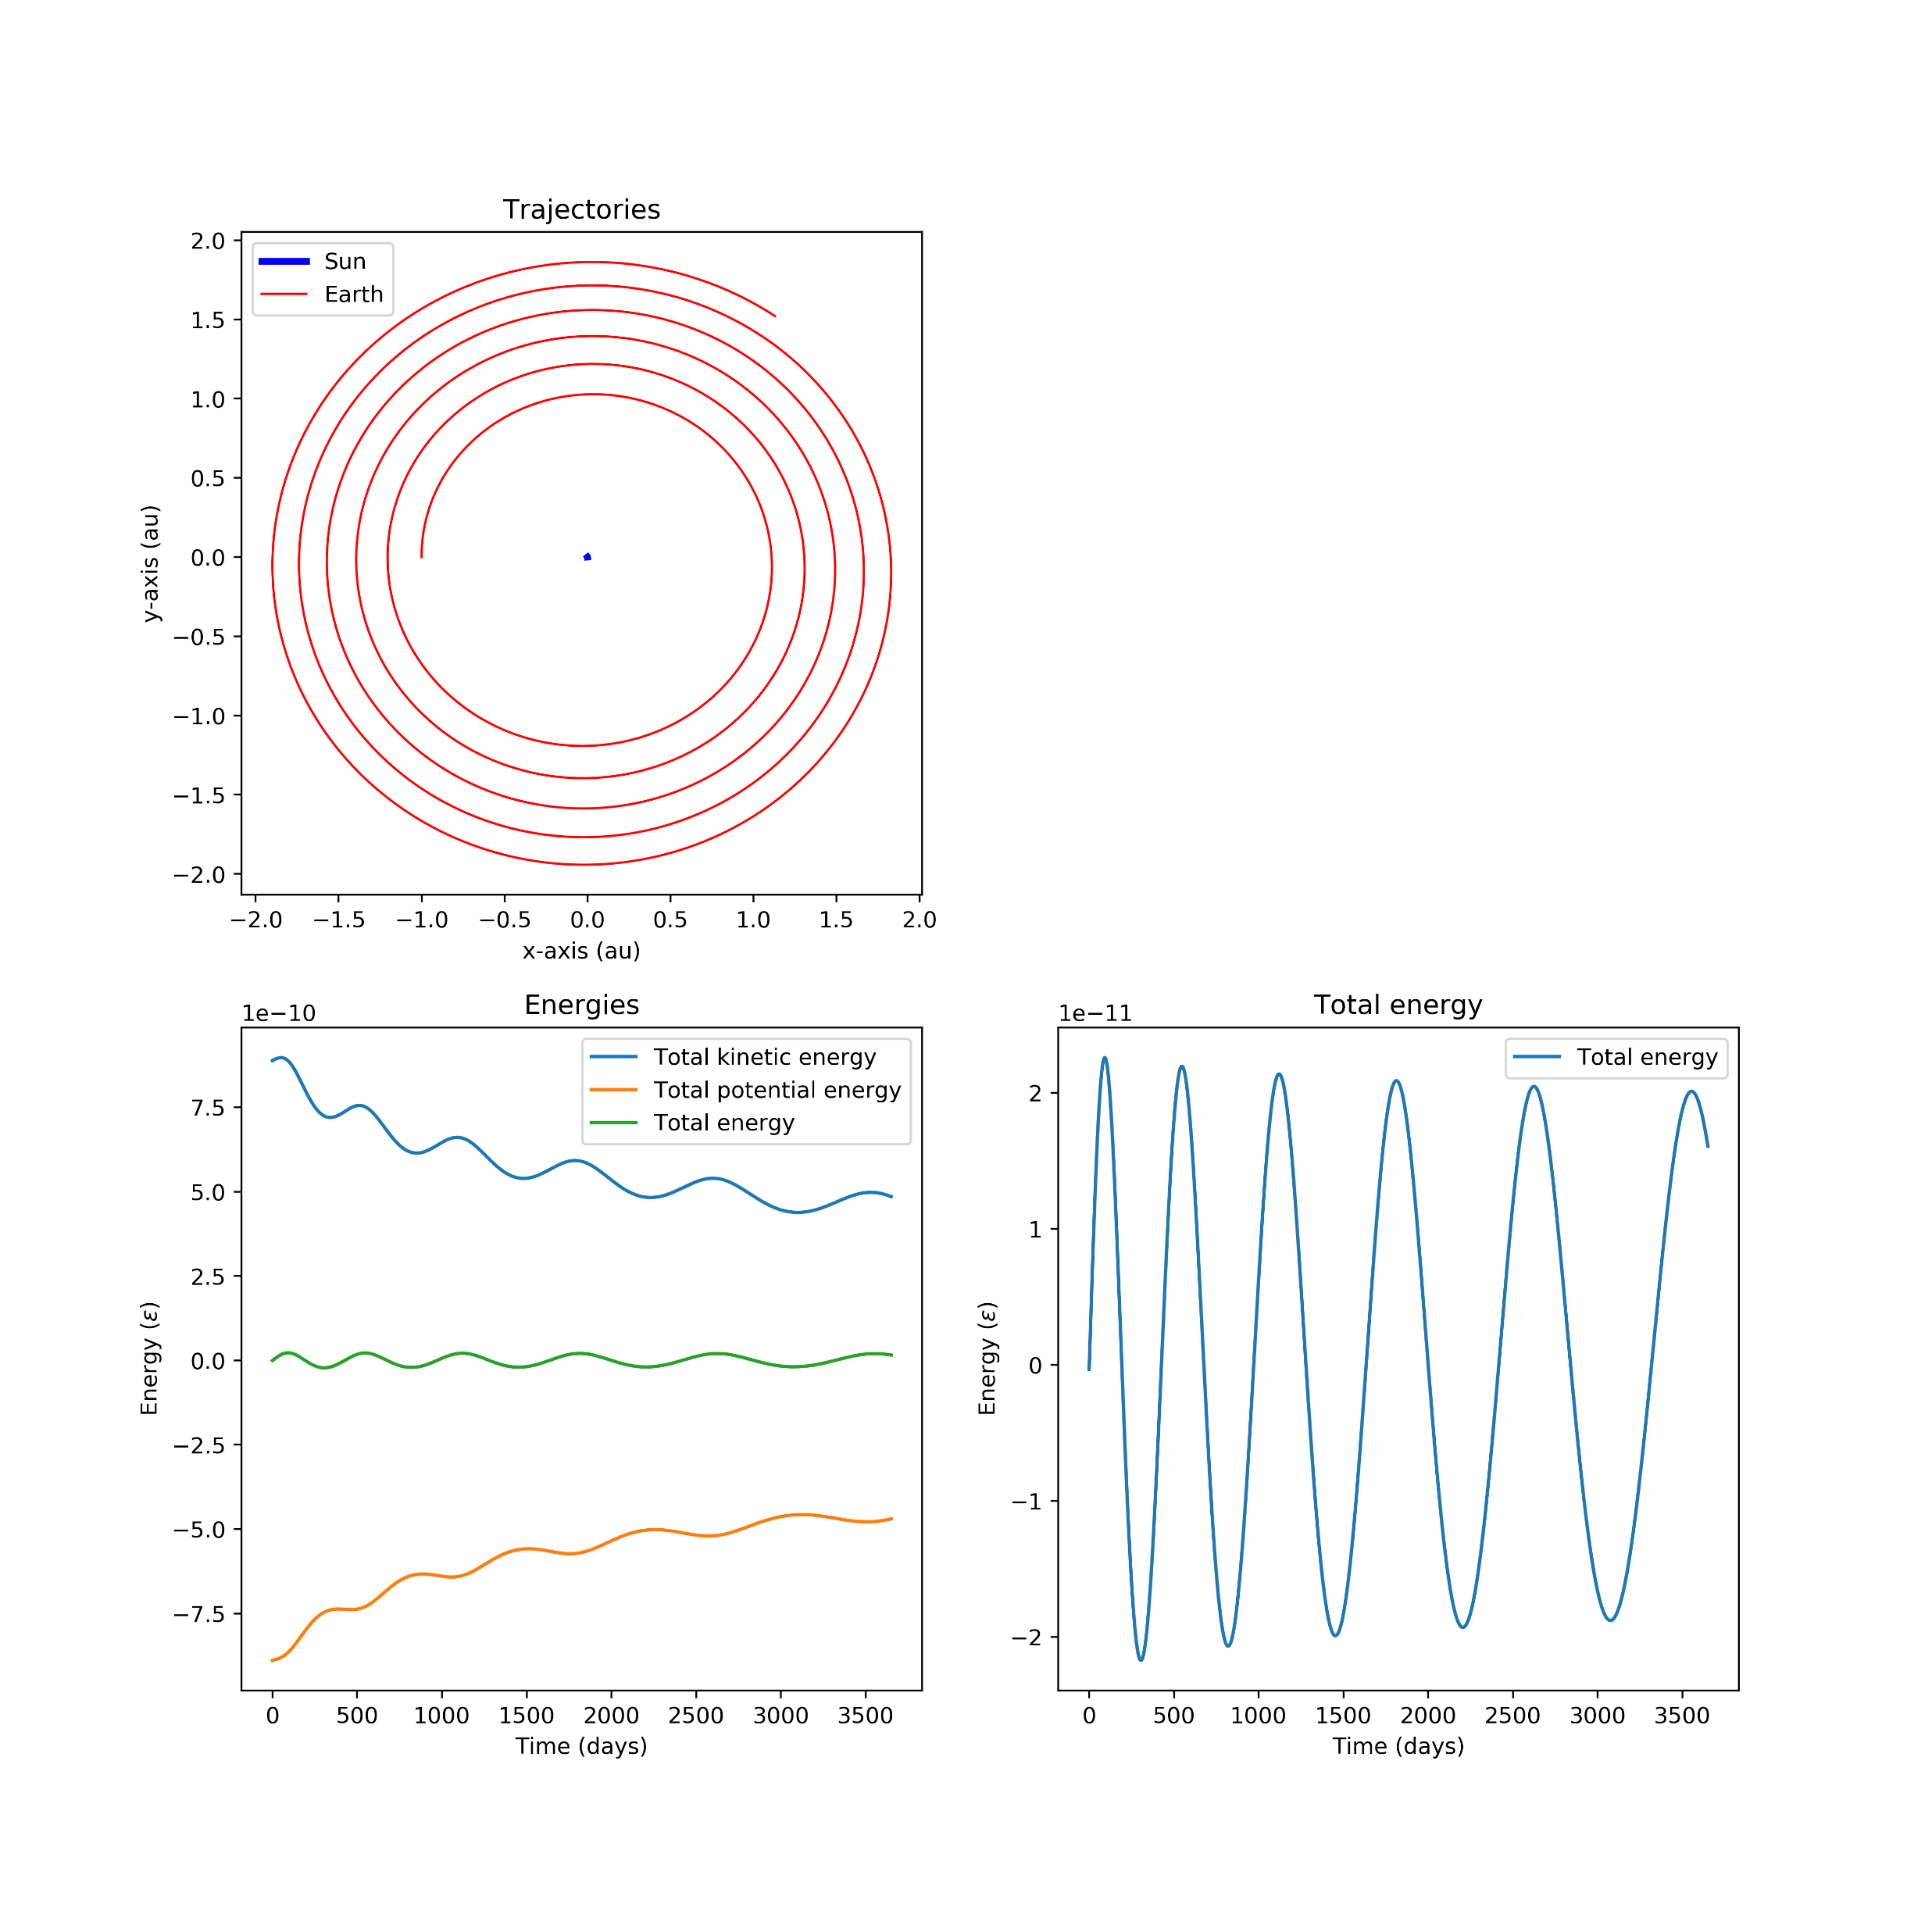
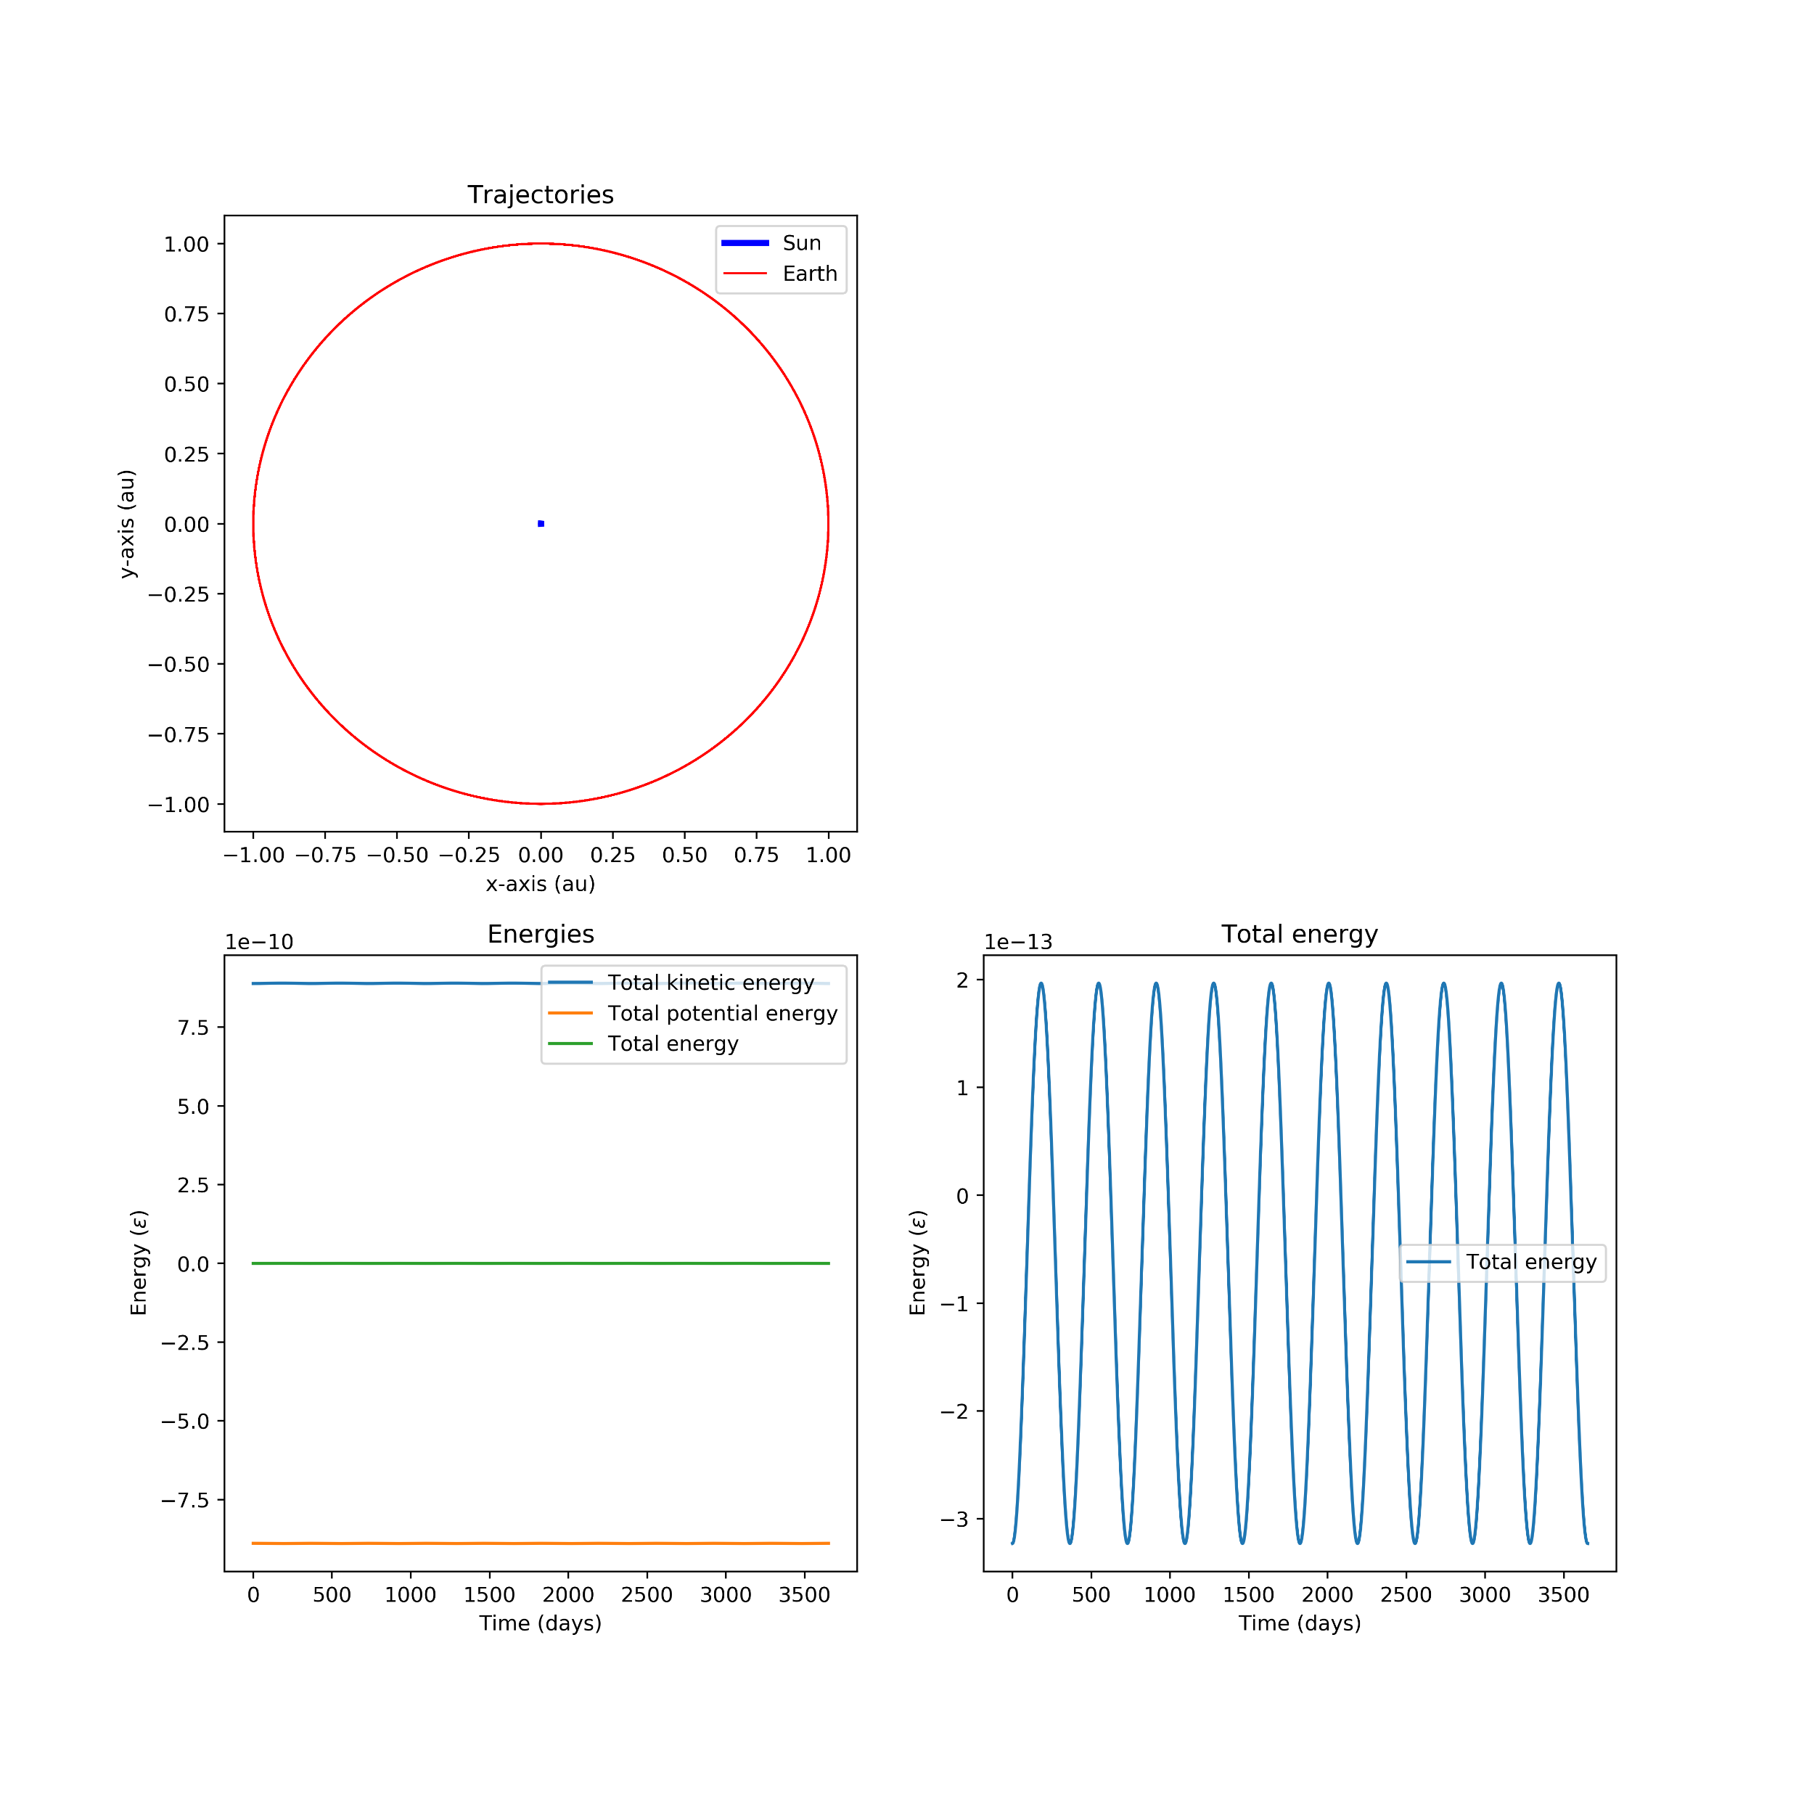
积分算法
Euler's method
Velocity-Verlet's method

Slide 8
积分算法
“Good” algorithm means: energy conservation, time reversibility, volume preservation in phase space
Time step: as large as possible until energy is not conserved,
usually ~ 1 - 10 fs
Lyapunov instability? Ergodicity?
Lyapunov instability: 随模拟时间的增加，模拟轨迹以指数方式偏离实际的轨迹

Slide 9
积分算法
时间反演(time reversible)
Verlet, Velocity Verlet are time reversible
Beeman, Velocity is not time reversible
能量守恒(energy conservation)
短时间
低阶方法（如Verlet）可能短时间尺度内能量涨落比较大
长时间
高阶方法能量可能会漂移

Slide 10
Ensembles
1. Microcanonical ensemble: NVE
Particle number (N) ̶ volume(V) ̶ energy (E) are conserved
2. Canonical ensemble: NVT
Particle number (N) ̶ volume(V) are conserved @ given (average) temperature
3. NPT: fixed particle number, Pressure and temperature

Slide 11
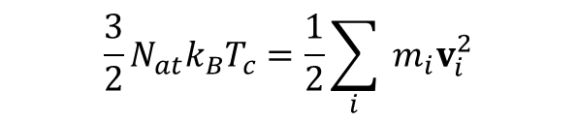

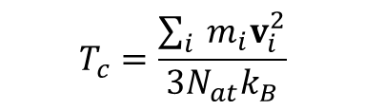
Thermostat
Instantaneous Temperature:
$$\frac{3}{2}N_{at}k_{B}T_{c}=\frac{1}{2}\sum_{i}{ }m_{i}v_{i}^{2}$$
$$T_{c}=\frac{\sum_{i}{ }m_{i}v_{i}^{2}}{3N_{at}k_{B}}$$
1. Velocity Rescaling
$${v^{′}}_{i}=\sqrt{T/{T_{c}}}v_{i}$$
Velocity scaling schemes do not strictly follow the canonical ensemble, though in practice, the amount they deviate from canonical is quite small. It leads to discontinuities in the momentum part of the phase space trajectory due to the rescaling procedure at each time step.

Slide 12
Thermostat
2. Nosé-Hoover Thermostat
The Nosé-Hoover thermostat is a deterministic algorithm for constant temperature molecular dynamics simulations.
Originally developed by Nosé and was improved further by Hoover. Although the heat bath of Nosé-Hoover thermostat consists of only one imaginary particle, simulation systems achieve realistic constant- temperature condition (canonical ensemble). The Nosé–Hoover thermostat has been commonly used as one of the most accurate and efficient methods for constant-temperature molecular dynamics simulations.

Slide 13



Thermostat
Introduce a friction variable 𝜉 𝑡
as “heat bath”
q = ^{pi}
i
m
i
p_{i} = F_{i} − ξ (t )p_{i}
N
_{p}2
3
Qξ (t ) = ∑ ^{i} − Nk_{B}T₀
i=1 2mi
2
𝑄 is the “heat bath” mass. Large 𝑄 is weak coupling.
The value of this parameter must be set carefully, because if it is chosen to be too small, the phase space of the system will not be canonical, and it is chosen to be too large the temperature control will not be efficient.

Slide 14
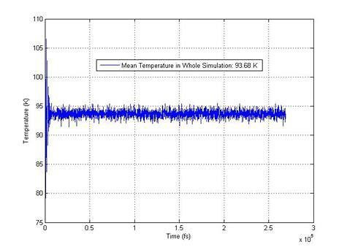
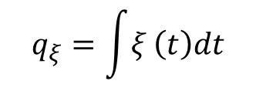
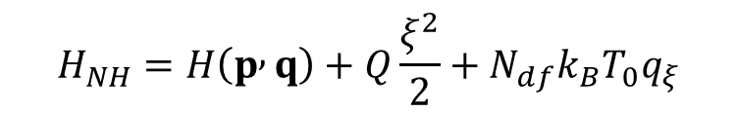
Thermostat
The Hamiltonian of the system + heat bath is:
$$H_{NH}=H\left(p , q\right)+Q\frac{ξ^{2}}{2}+N_{df}k_{B}T_{0}q_{ξ}$$
$$q_{ξ}=\int{ξ}\left(t\right)dt$$
The energy of the physical system fluctuates, but the energy of the physical system plus the heat bath is conserved.

Slide 15
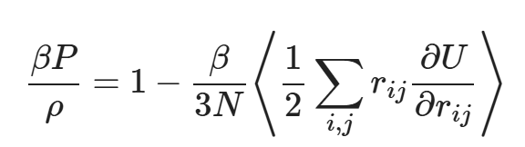
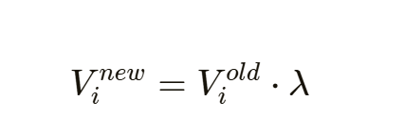
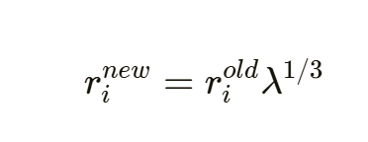
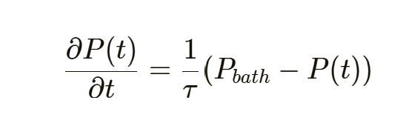
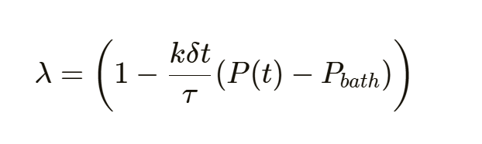
Barostat
Instantaneous Pressure:
Berendsen barostat

Slide 16
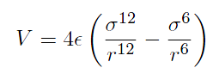
原子间的相互作用势
两体势： Lennard-Jones (LJ)，Morse
惰性气体、简单金属
原子内嵌势：Embed Atom Methods (EAM)
简单金属、过渡金属
紧束缚势：Tersoff, Brennerd, Stillinger-WeberPotential
半导体
Lennard-Jones (LJ)势
r_{c}

Slide 17
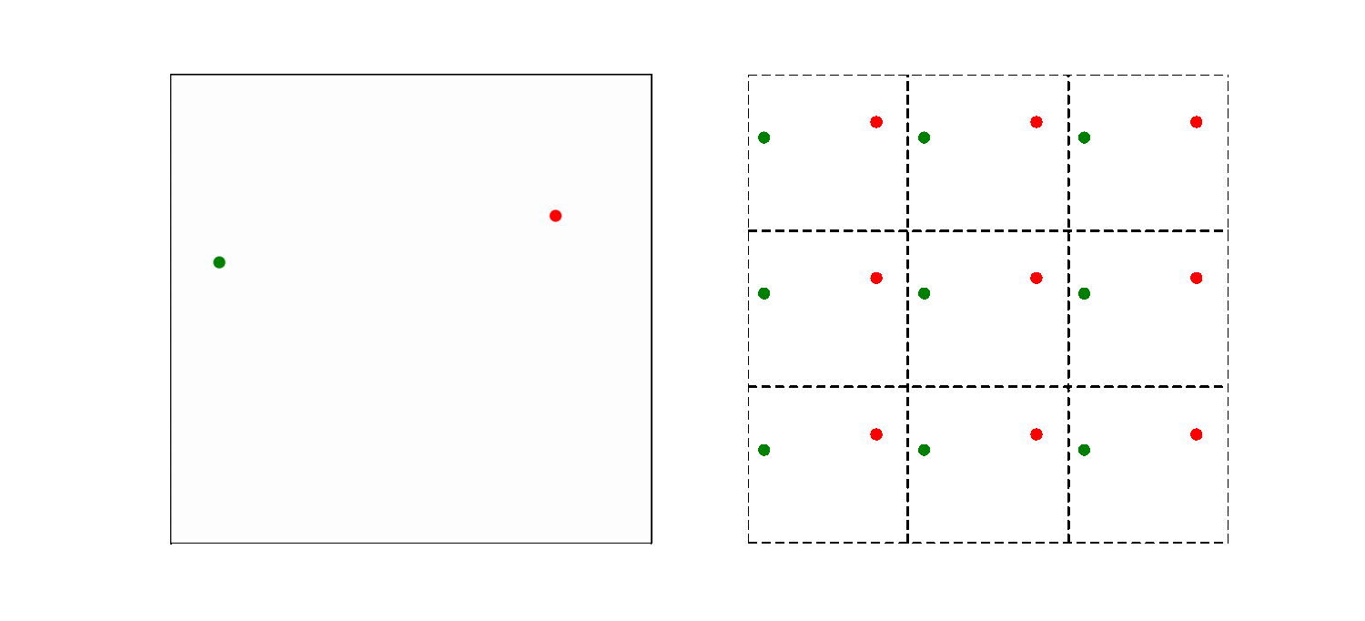
周期性边界条件
Macroscopic systems O(10²³) particles.
We eliminate surfaces from simulation.
Allows us to get at bulk properties with few particles.
Applied to solids, liquids, gases, and plasmas.
Some finite-size effects remain, but can often be removed with scaling.

Slide 18
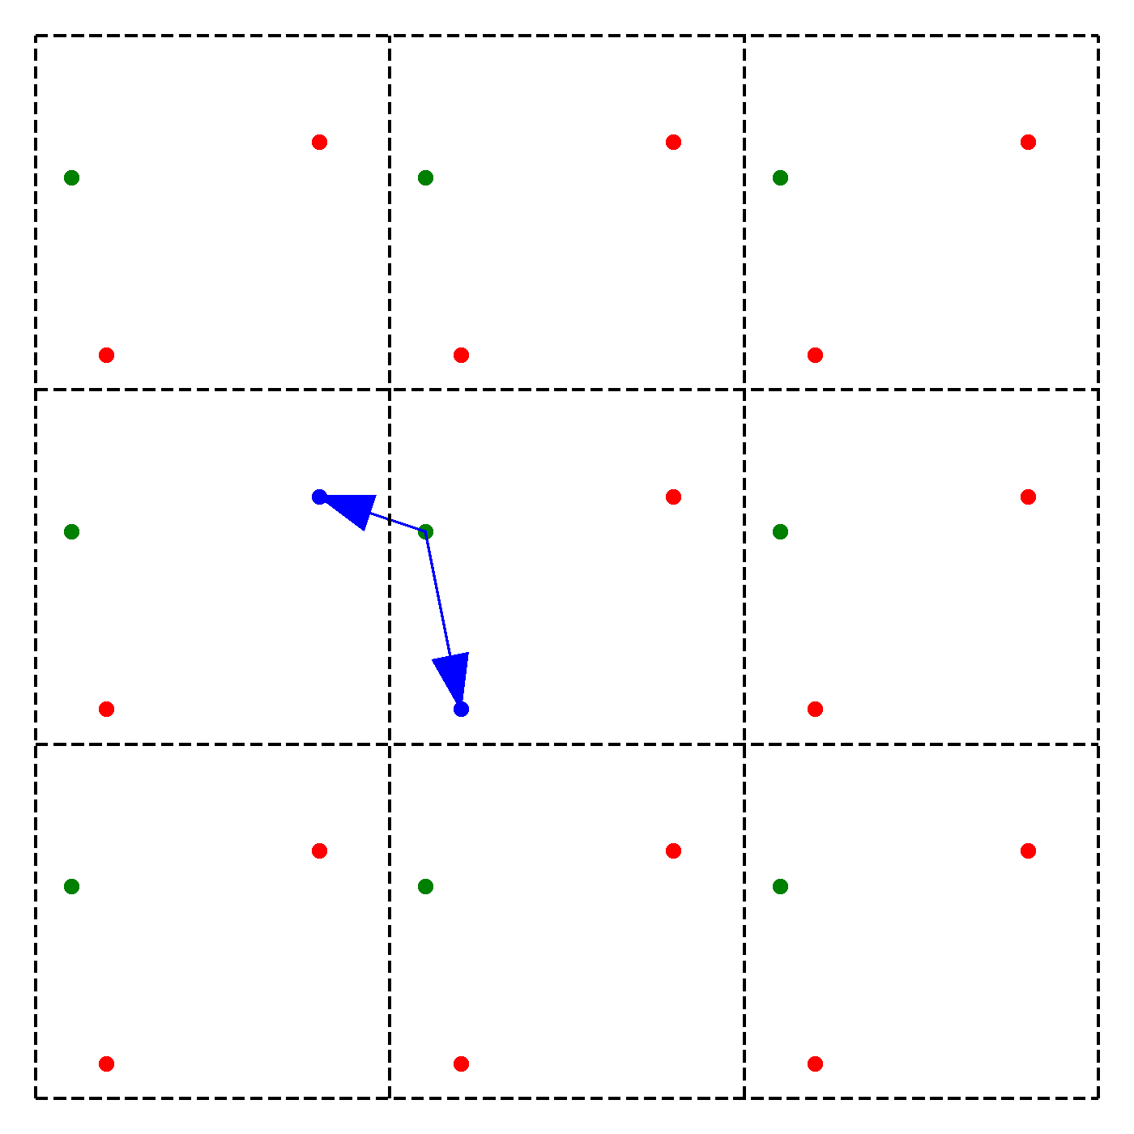
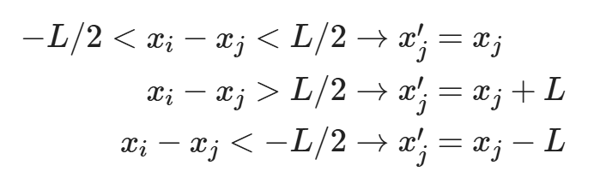
周期性边界条件
Minimum Image Convention: Take the closest distance |r|_{M} = min (r+nL)
How to handle the “tail” of the potential:
Potential cutoff : V(r)=0 for r > L/2
continuous potential: V_{c}(r) = V(r) - V(r_{c}) for r < r_{c}.
continuous V&F: V_{c}(r) = V(r) - V(r_{c}) - ∇V(r_{c})*(r-r_{c}) for r < r_{c}.
Image potential: V_{I} = Σ v(r_{i}-r_{j} + nL)
For long-range potential this leads to the Ewald image potential.
You need a charge background and convergence factor (more later)

Slide 19
LJ Force Computation
! Loop over all pairs of atoms.
do i=2,natoms
do j=1,i-1
!Compute distance between i and j.
r2 = 0
do k=1,ndim
dx(k) = r(k,i) - r(k,j)
!Periodic boundary conditions.
if(dx(k) .gt. cell(k)/2) dx(k) = dx(k)-cell(k)
if(dx(k) .lt. cell(k)/2) dx(k) = dx(k)+cell(k)
r2 = r2 + dx(k)*dx(k)
enddo
!Only compute for pairs inside radial cutoff.
if(r2.lt.rcut2) then
r2i=sigma2/r2
r6i=r2i*r2i*r2i
!Shifted Lennard-Jones potential.
pot = pot+eps4*r6i*(r6i-1)- potcut
!Radial force.
rforce = eps24*r6i*r2i*(2*r6i-1)
do k = 1 , ndim
force(k,i)=force(k,i) + rforce*dx(k)
force(k,j)=force(k,j) - rforce*dx(k)
enddo
endif
enddo
enddo
We can do better with the PBC!
dx(k)=dx(k)-cell(k)*nint(dx(k)/cell(k))
Why?

Slide 20
Complexity is defined as how a computer algorithm scales with the number of degrees of freedom (atoms).
Number of terms in pair potential is N(N-1)/2 ≈ O(N²)
For short-range V(r), use neighbor tables to reduce it to O(N).
Explicit Neighbor list (Verlet) for systems that move slowly (keep a list and update occassionally.)
Bin Sort list (sort particles into bins and sum over neighboring bins)
Long-range potentials require more sophisticated treatment:
Ewald sums are O(N^{3/2})
Fast Multipole Algorithms are O(N), for very large N.
Tree Methods
More later…

Slide 21
结构优化
Find a local minimum on PES
$$f\left(\vec{x}\right)=a+\vec{b}\vec{x}+\frac{1}{2}\vec{x}B\vec{x}=\overset{‾}{a}+\frac{1}{2}\left(\vec{x}−{\vec{x}}^{0}\right)B\left(\vec{x}−{\vec{x}}^{0}\right) B_{ij}=\frac{∂^{2}f}{∂x_{i}∂x_{j}}$$
Gradient
𝜕𝑓
𝑔 𝑥 = = 𝐁 𝑥 − 𝑥 ⁰
𝜕𝑥
Newton’s method (find the root of the derivative)
𝑥 = 𝑥 ¹ − 𝐁⁻¹𝑔 𝑥 ¹

Slide 22
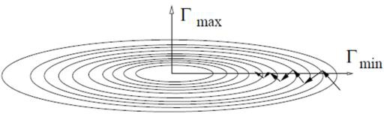
结构优化
Steepest Descent (SD)
Guess
𝑥 ¹
Calculate
𝑔 𝑥 ¹
Step along the steepest descent direction
1
𝑥 ² = 𝑥 ¹ − 𝑔 𝑥 ¹
^{Γ}max
Repeat to get converged geometry

Slide 23
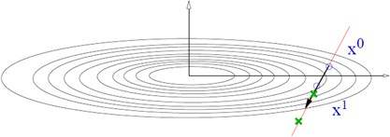
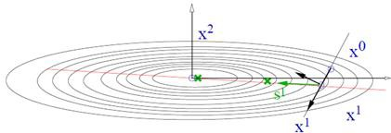
结构优化
Conjugate Gradient (CG)
The CG Algorithm
SD from 𝑥 ⁰ along
𝑔 ⁰
Line minimization to 𝑥 ¹
New gradient 𝑔 ¹ = 𝑔 𝑥 ¹ and conjugated gradient 𝑠 ¹
Points directly towards the minimum
Line minimization is done using a variant of Brent algorithm
trial step along search direction (conjg. gradient scaled by POTIM)
quadratic or cubic interpolation using energies and forces at x₀ and x₁ allows to determine the approximate minimum
continue minimization as long as approximate minimum is not accurate enough

Slide 24
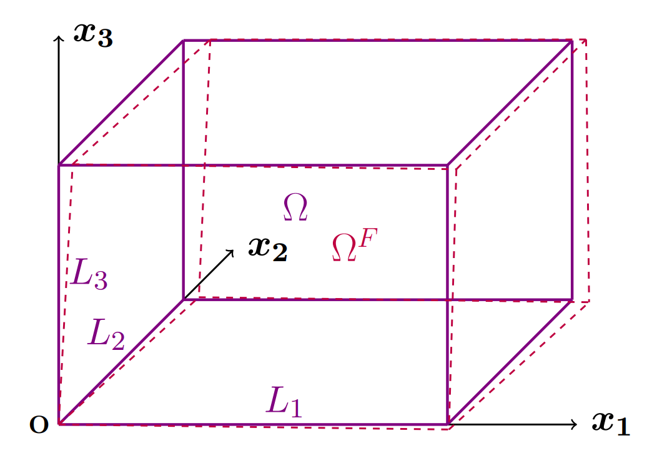
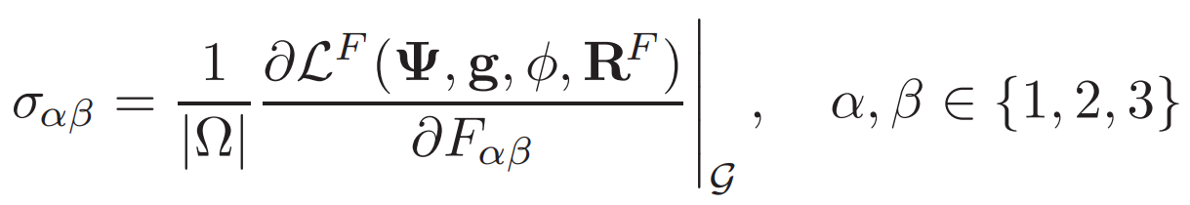
晶格优化
Optimization by hand: do a series of calculations at different volumes
Optimization by hand: fit to thermodynamics equations
Automatic optimizations based on Hellmann-Feynman stresses
Selection of Initial Structure and Calculation of Hellmann-Feynman Stresses
Update Lattice Parameters: Based on the calculated stresses, adjust the lattice constants and atomic positions to reduce the total energy of the system.
Iterative Optimization: Repeat the stress calculations and structure adjustments until the stresses meet the convergence criteria and the system's total energy reaches a minimum.
Hellmann-Feynman stress tensor can be defined as:

